Slide 1



WELCOME TO
Digital Logbook Maintenance System
Presented By

Slide 2
Group Members
Charlie B
Capt Ishrak Jahan Ema
Lt Labiba Islam
Lt Lopa Ahmed
Lt Tanvir Nahian Swapnil
Lt Safkat Rahman

Slide 3
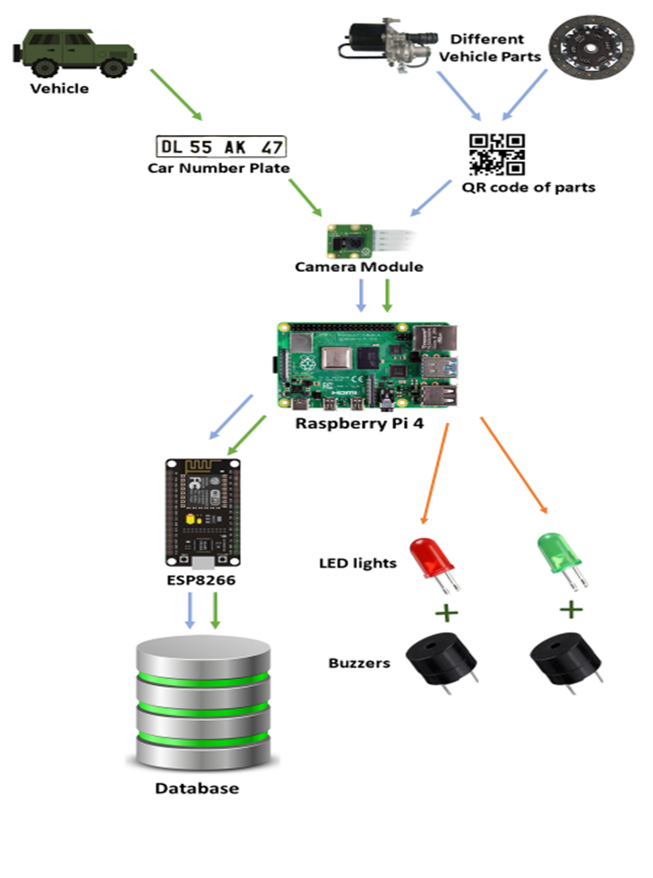
System Architecture
Figure: System Architecture of Digital Logbook Maintenance System (DLMS)

